Slide 1
Comp 472 - Project 3
Game of Line ‘em Up
Matthew Pan, Zahra Nikbakht, Le Cherng Lee

Slide 2
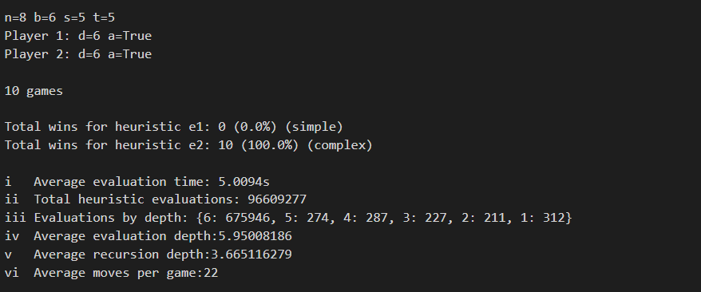
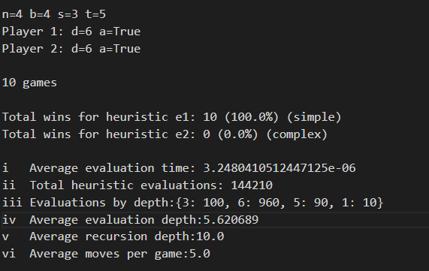
Output

Slide 3
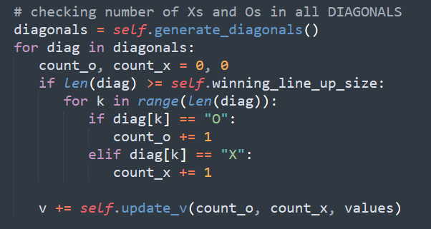
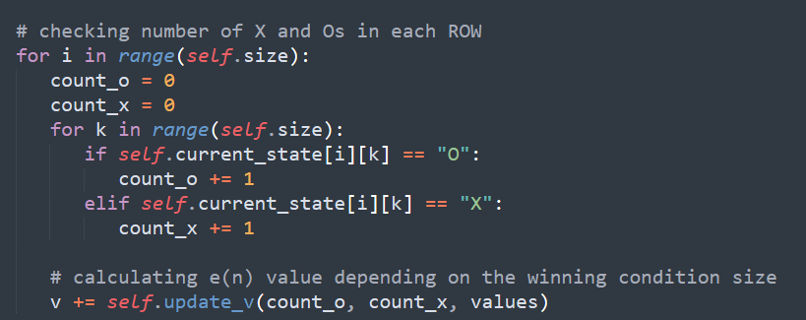
Heuristics

Slide 4
Analysis: Parameters
Depth
Alpha-Beta vs Minimax
Heuristic 1 vs Heuristic 2

Slide 5
Thank you.

